Slide 1

Football Soccer Analyzer
By Gensik Rubio

Slide 2
Introduction
Objective: To analyze football game footage by detecting and tracking players, referees, and the ball, and visualize key metrics like ball possession, speed, and distance traveled to assess game dynamics.
Scope: Processing video data, implementing object detection and tracking, and visualizing the results.
Technology Used:
YOLOv5: For high-accuracy object detection.
ByteTrack: For robust tracking of detected objects.
OpenCV: For video processing and adding visual annotations
I will mostly follow a YouTube tutorial and then implement Kalman filters to improve ball tracking.

Slide 3
Video Analysis Workflow
Steps:
Load Video Frames: Extract individual frames from the video.
Object Detection: Identify players, referees, and the ball in each frame using YOLOv5.
Object Tracking: Track the movement of detected objects across frames using ByteTrack.
Annotate Frames: Visualize tracking results by drawing annotations on video frames.

Slide 4
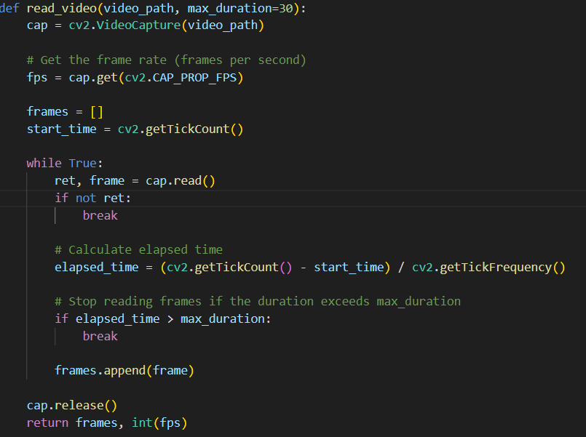
Video Processing

Slide 5
Training with Roboflow and YOLOv5
Data Collection & Annotation:
Roboflow: Collected and annotated images for object detection. Roboflow’s platform facilitated efficient dataset management and augmentation.
Dataset Preparation:
Roboflow: Prepared and exported the dataset with preprocessing and augmentation for enhanced model training.
Model Training:
YOLOv5: Utilized YOLOv5 for training the object detection model, known for its speed and accuracy.
Process: Configured the model, set hyperparameters, and trained it on the prepared dataset.

Slide 6
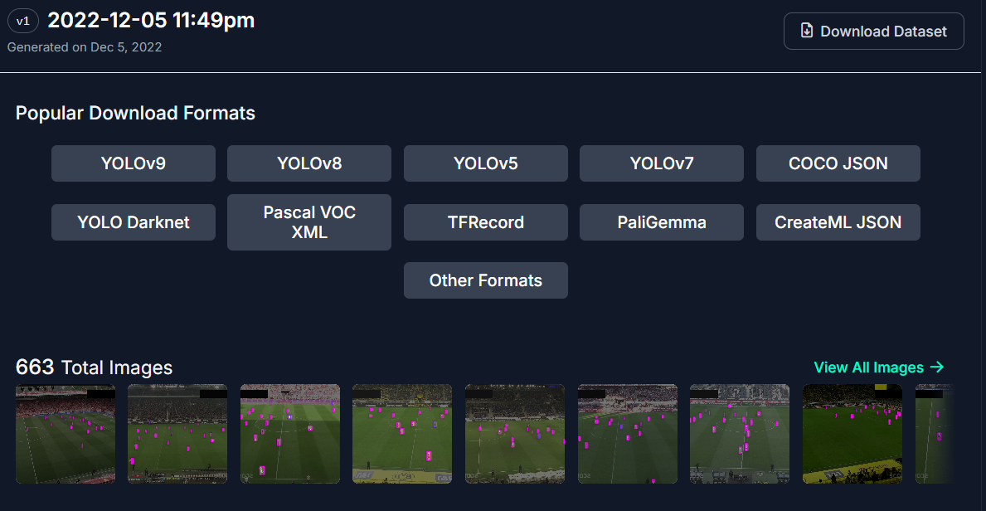
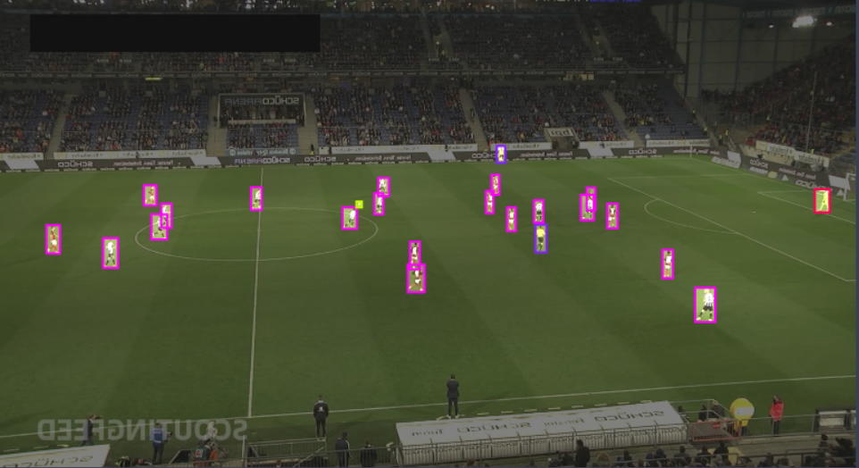
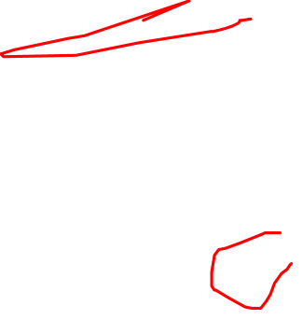
Roboflow dataset

Slide 7
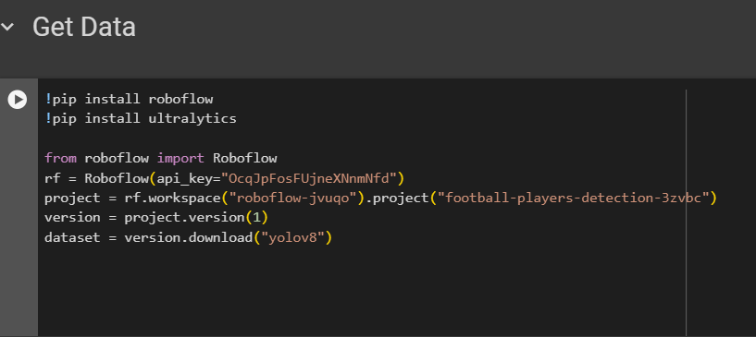
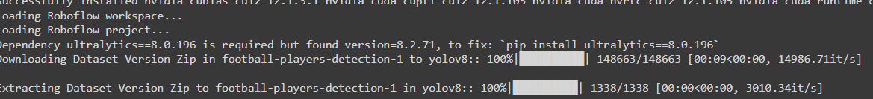

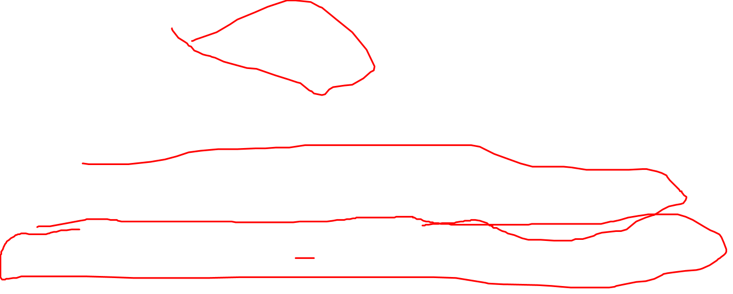
Training dataset

Slide 8
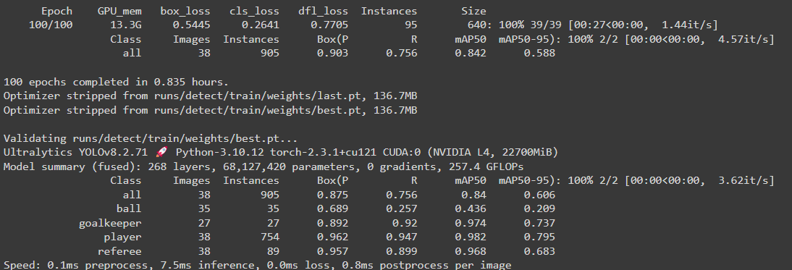
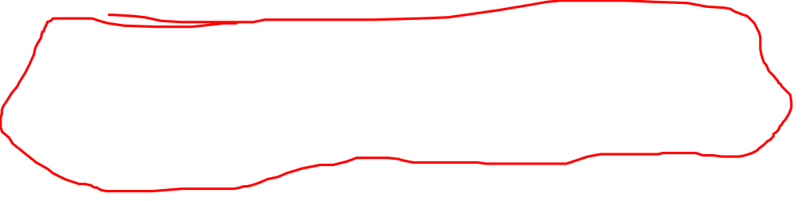
best.pt Model Summary

Slide 9
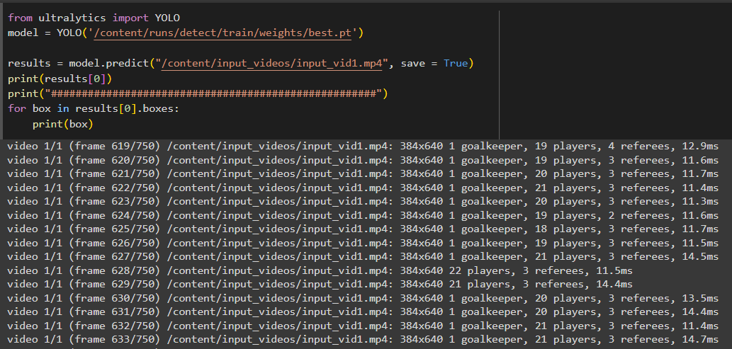

Using Trained Model

Slide 10
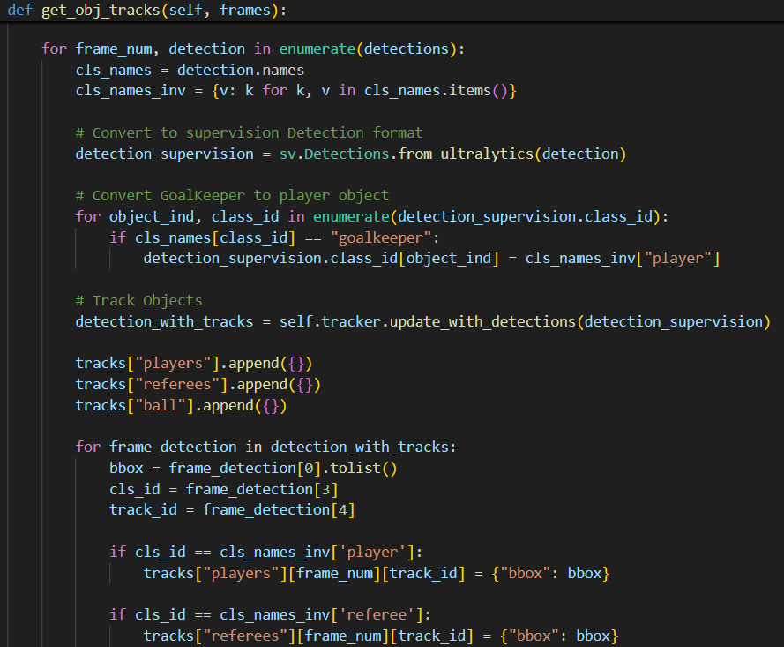
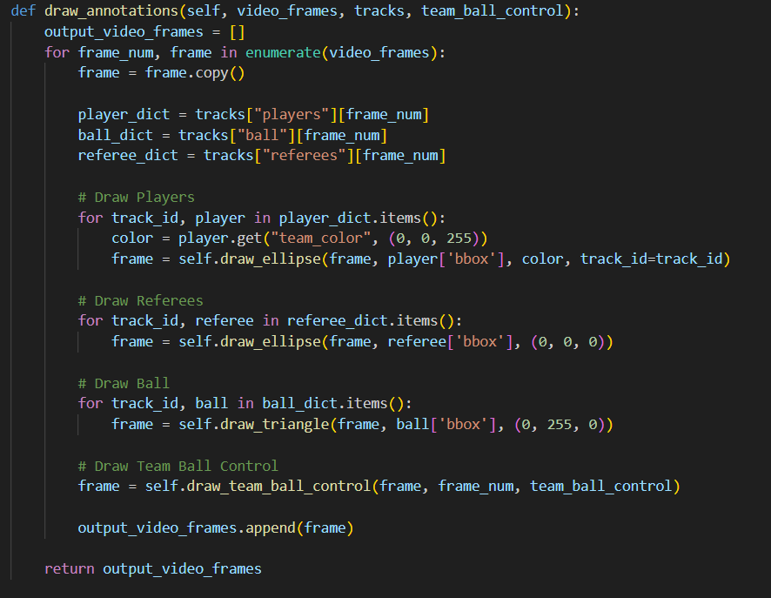
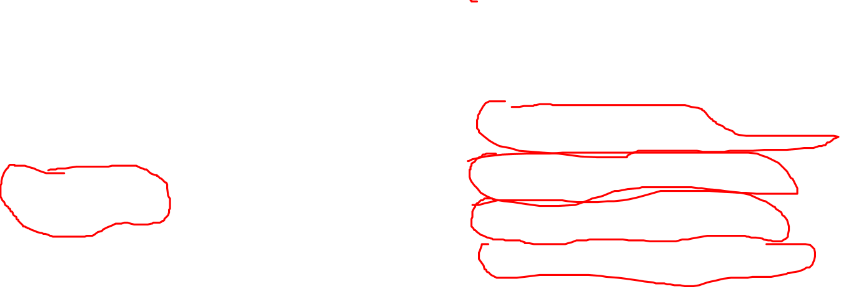
Tracking and Annotation
Notes:
The get_obj_tracks function is responsible for processing a sequence of video frames to detect and track objects (players, referees, and the ball) within the scene.
It begins by detecting objects in each frame using the detect_frames function (assumed to be defined elsewhere). Subsequently, it initializes empty lists to store tracking data for each object category.
For each frame, the detected objects are converted into a suitable format for the tracking algorithm. The function then employs an object tracker to associate detections across frames, forming object tracks.
To categorize detected objects, the function assigns them to respective categories (players, referees, or ball) based on their class labels. A special case is handled for goalkeepers, which are classified as players for tracking purposes.
The function introduces a Kalman filter for ball tracking, predicting ball positions based on previous measurements and updating the predictions with current detections. This helps in smoothing ball trajectories and improving tracking accuracy.
Finally, the function returns a structured output containing tracked objects and their attributes, including bounding boxes and, in the case of the ball, Kalman filter-based positions.

Slide 11
Kalman Filter Integration for Ball Tracking
Description: The Kalman filter is used to predict and smooth the ball’s trajectory, reducing the impact of noise and irregularities in ball movement data.
Benefits:
Prediction: Estimates future positions based on current state and dynamics.
Smoothing: Reduces the effect of measurement noise.

Slide 12
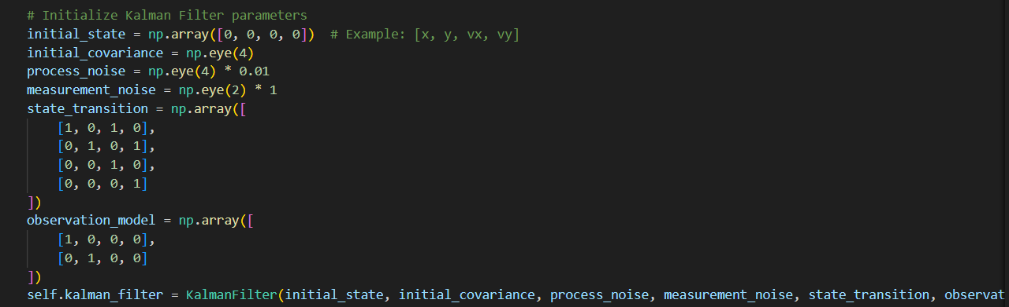
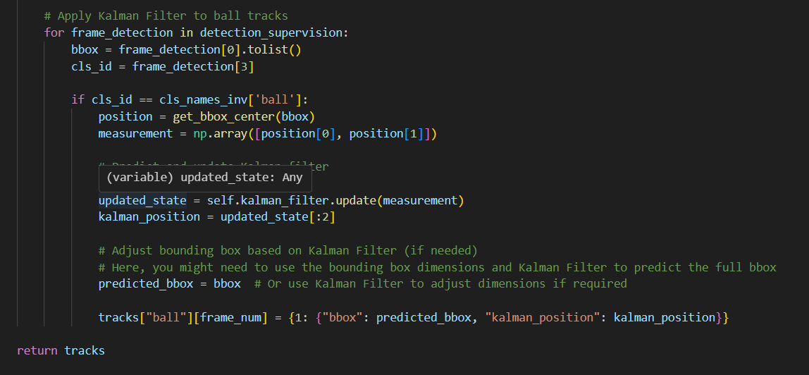
Initializing and Running Kalman Filters

Slide 13
Program’s Tools
Key Features:
Camera Movement Estimator: Stabilizes video by estimating camera movements using feature extraction and homography.
Perspective Transformer: Transforms frames to a top-down view using a perspective transformation matrix.
Speed and Distance Calculation: Tracks object positions, stabilizes frames, transforms coordinates, and calculates metrics using frame timestamps.
Ball Possession Calculation: Using k-means

Slide 14
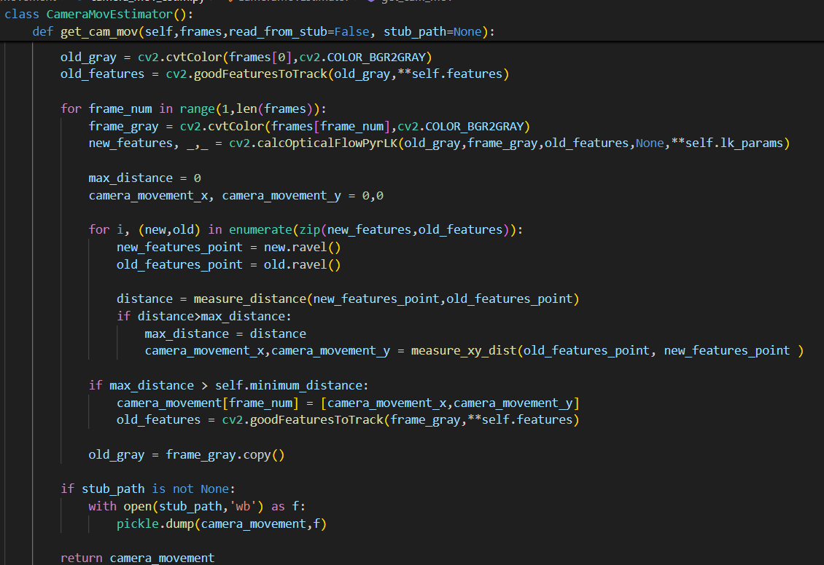
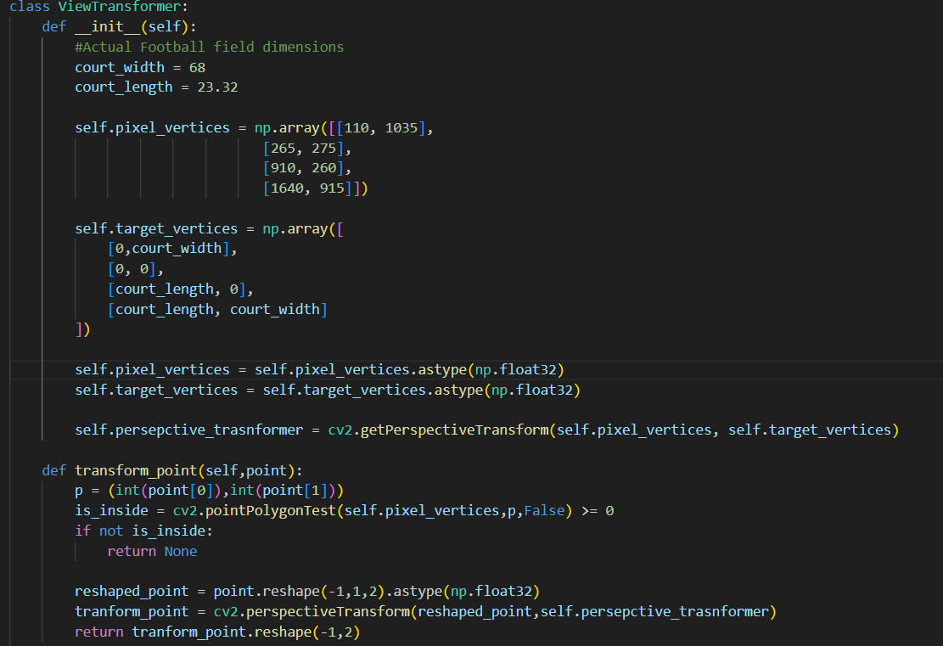
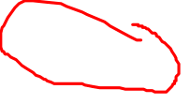
Implementation
Notes:
View Transformer Code: The ViewTransformer class is designed to transform points from pixel coordinates in an image to coordinates on a defined football field. This is useful for tasks like calculating player positions, distances, and speeds on the actual field. The class provides methods to:
Define a perspective transformation based on image and real-world coordinates.
Transform individual points from image to real-world coordinates.
Apply the transformation to a set of tracks, adding transformed positions to the track data.

Slide 15
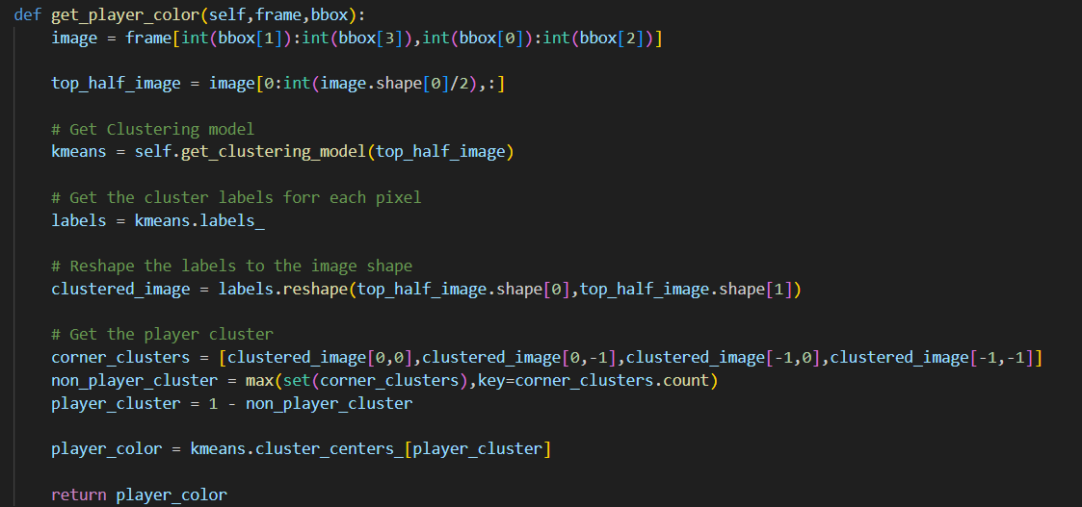
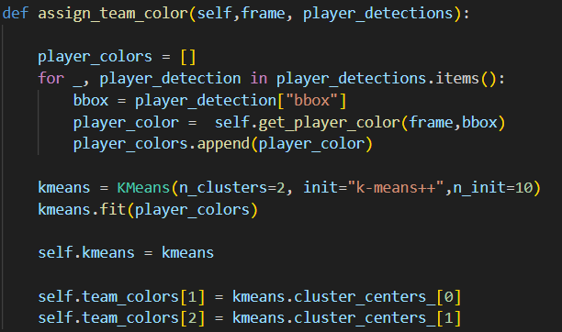
Ball Possession using KMeans
Notes:
KMEANS: The TeamAssigner class is designed to determine the team affiliation of players in a football game based on their jersey colors. It employs a color-based approach, using K-Means clustering to identify dominant colors within player bounding boxes. By analyzing the upper half of player images, the code isolates jersey colors and assigns players to teams based on color similarity. The class maintains a dictionary to store player-team mappings, improving efficiency for subsequent player assignments.

Slide 16
Visualization of Results
Description: Annotated video frames showing detected and tracked objects. Includes players, referees, and the ball.
Visuals: Examples of annotated frames with bounding boxes, tracking lines, and ball trajectories.

Slide 17
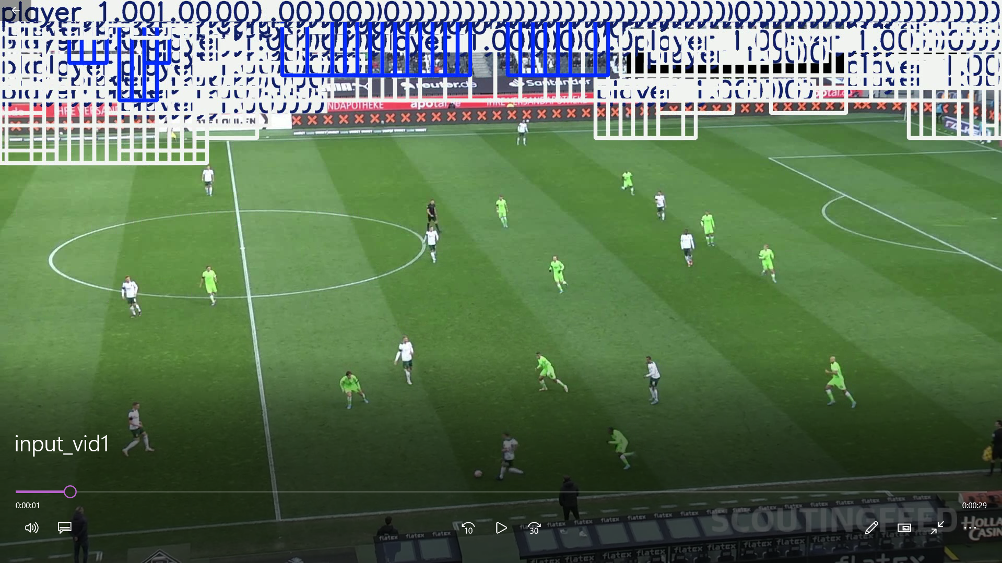
First Try

Slide 18
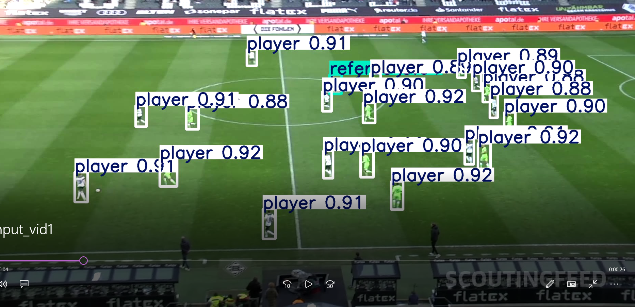
After Using Google Collab

Slide 19
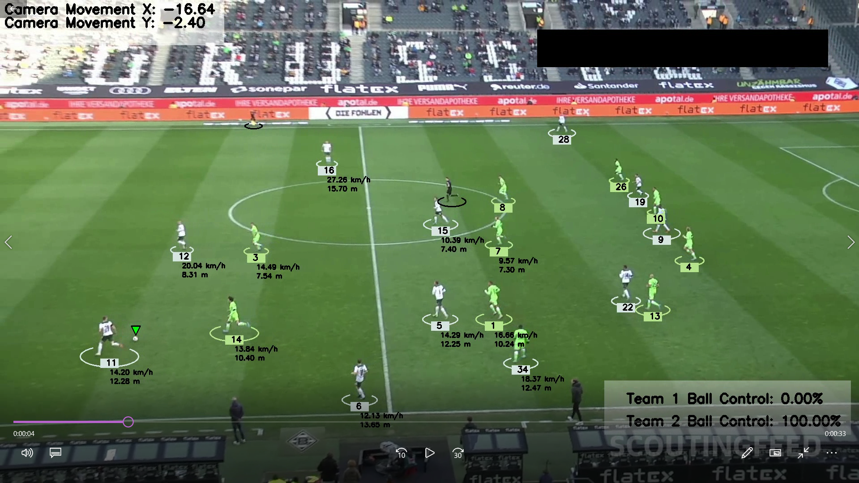
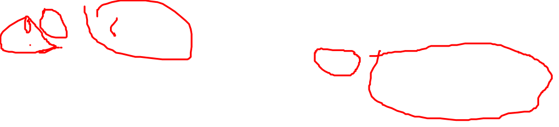
Final Product

Slide 20
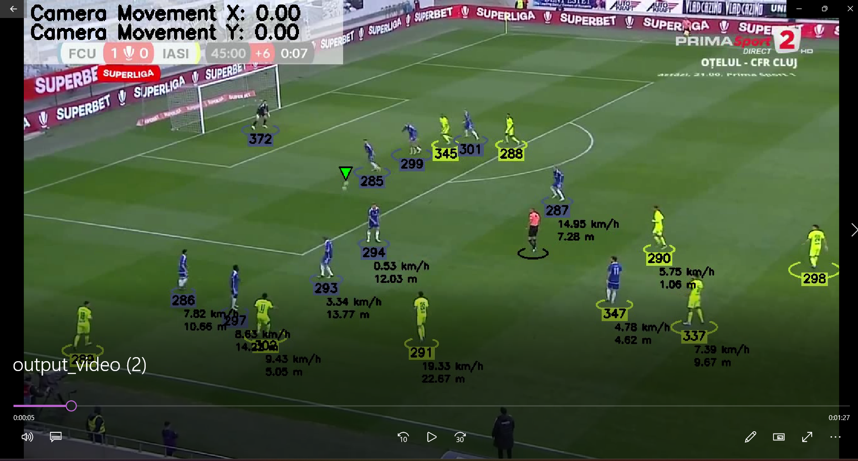
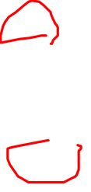
Different input video

Slide 21
Conclusion
Summary:
Successful implementation of object detection and tracking by training and using yolov5 model.
Effective use of Kalman filters to track the ball’s trajectory.
Visualization of results to enhance understanding of game dynamics.
Effective use of perspective transformations to calculate speed and dist traveled.

Slide 22
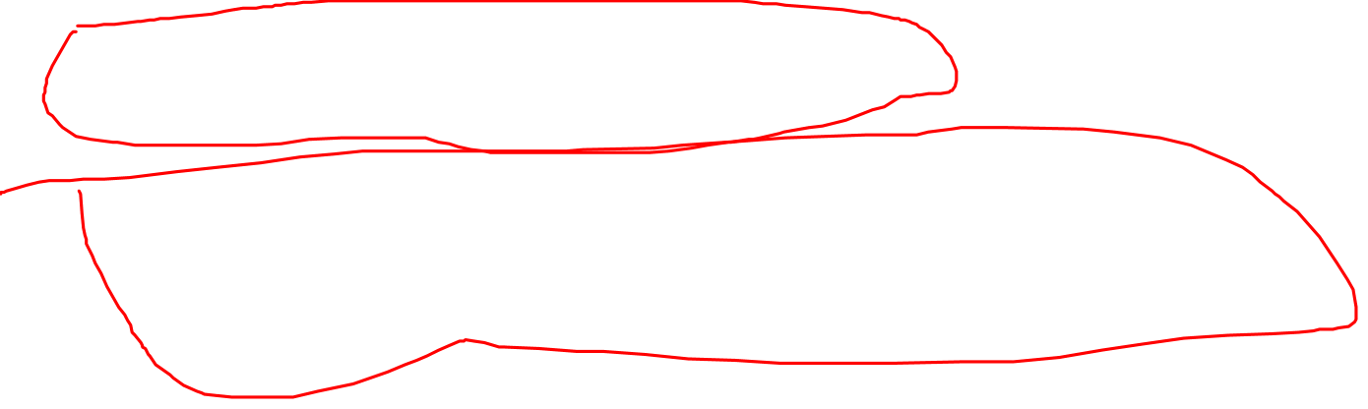
Works Cited
Tutorial:
https://www.youtube.com/watch?v=neBZ6huolkg
Roboflow dataset:
https://universe.roboflow.com/roboflow-jvuqo/football-players-detection-3zvbc/dataset/1

